Slide 1
Lattix Enterprise Suite
Understand, Define, and Control Software Architecture

Slide 2
Agenda
About Lattix
Lattix Flavors & Tool Set
Consolidated Feature List of Lattix
Leveraging the benefits in Navisysfo , AMP, HODPS DB
Metrics
Lattix Web
Lattix Command Line
Continuous Integration & Delivery (CI / CD)
Lattix Scripting
Additional Tools for Developers & Leads

Slide 3
About Lattix
Architecture analysis software since 2004
Company and technology have roots at MIT
“Software maintenance costs about 80% of a software product’s total life-cycle costs, and 40% of that cost is software understanding” – IEEE Computer Society
Lattix Architect makes software architecture:
Easy to understand
Easy to define and update
Easy to control

Slide 4
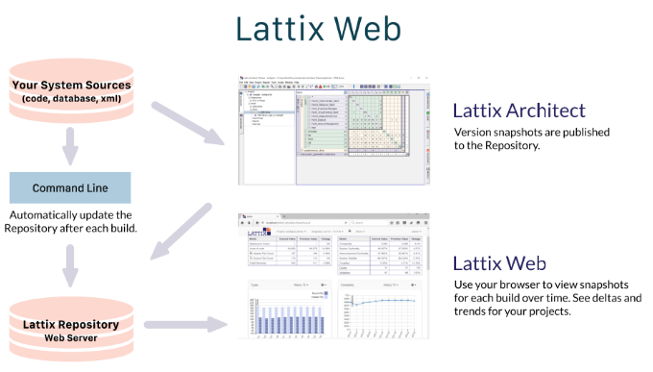
Lattix Flavors

Slide 5
Lattix Features & Benefits
DSM – Dependency Structure Matrix
Re-Engineer systems
Design Rules
Metrics - Complexity, Stability, Cyclicality, Coupling
Impact Report
DSM Web sharing
Custom Scripting & Special Editor
CI / CD (Jenkins) - Continuous Integration & Continuous Delivery
Lattix for Database

Slide 6
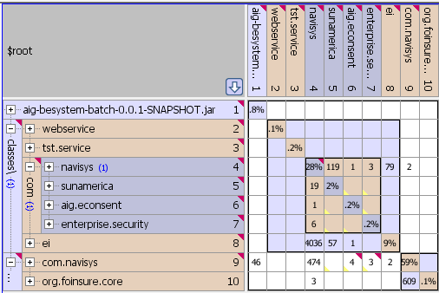
DSM
Scalable visualization
Comprehensive architectural analysis
Support for multiple languages and technologies

Slide 7
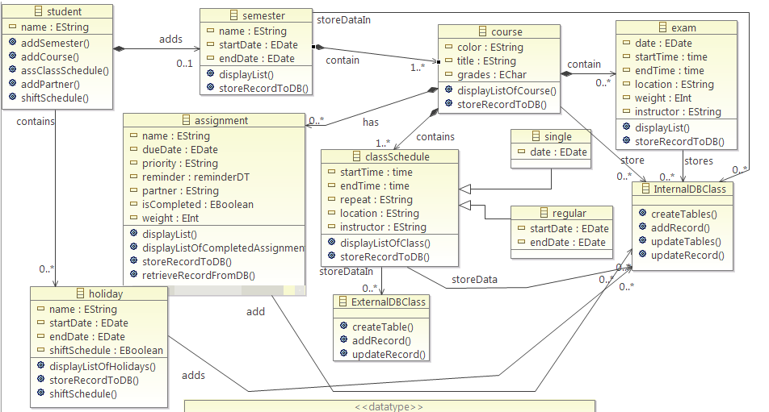
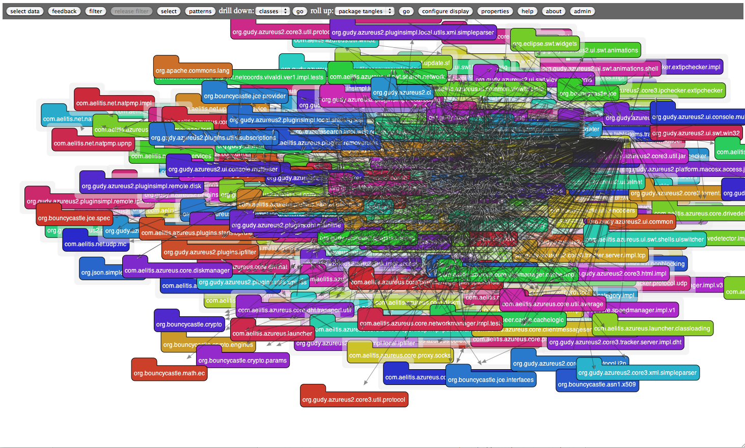
Without DSM Cluttered visualization for larger projects

Slide 8
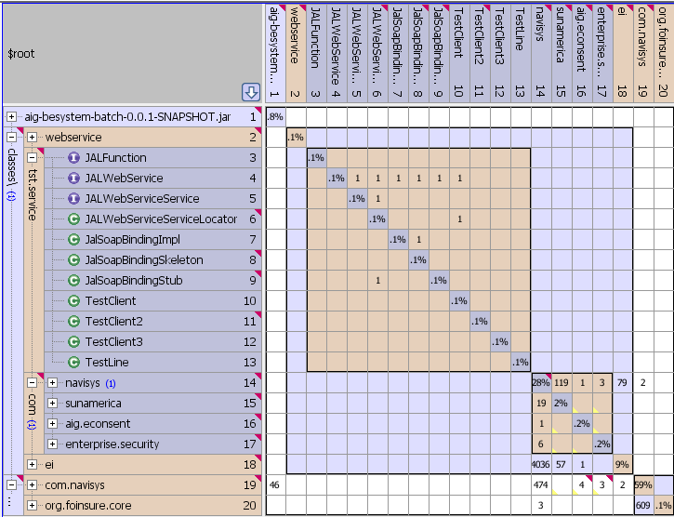
Architectural Impacts Identified
Problematic dependencies above the diagonal

Slide 9
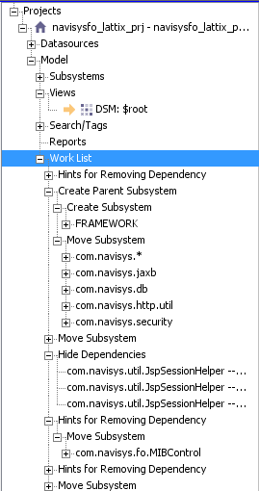
Work List

Slide 10
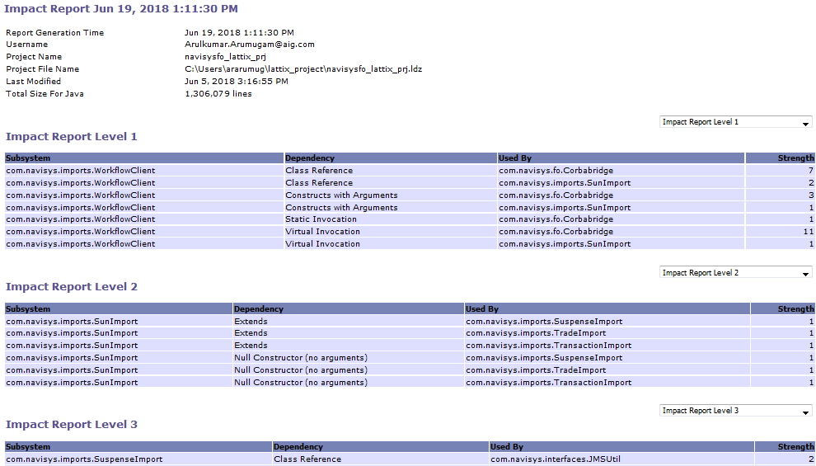
Impact Report

Slide 11
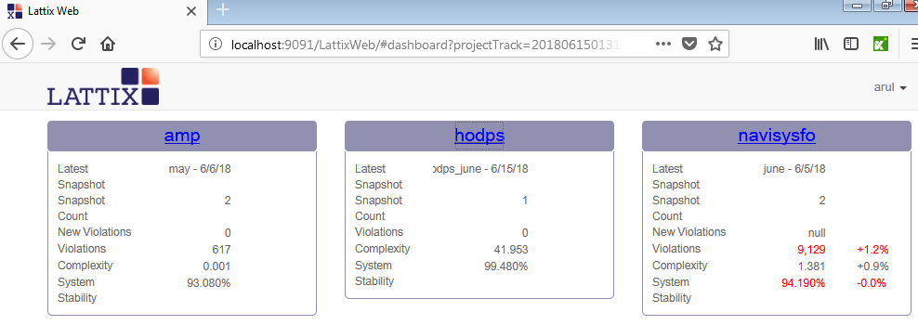
Lattix Web AMP – Navisysfo – Database (HODPS)

Slide 12
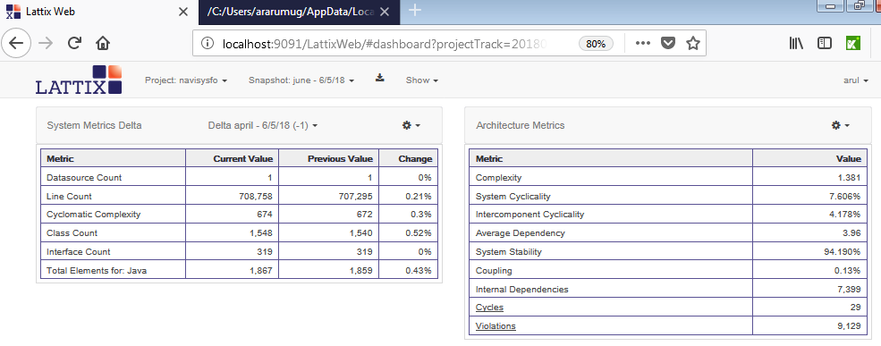
Lattix Web Identifying Delta Changes across Build Releases
Above snap shows the Delta changes between Navisysfo June Vs April Release

Slide 13
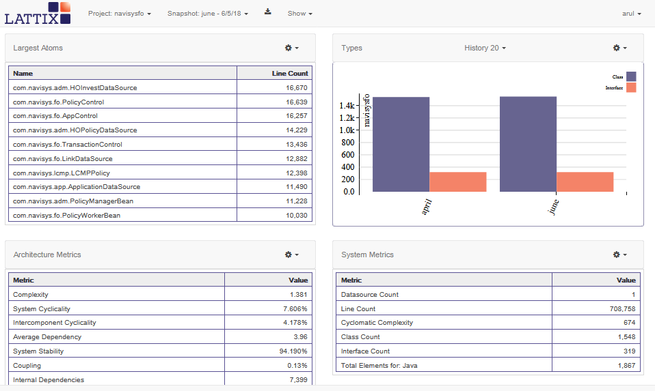
Lattix Web Metrics

Slide 14
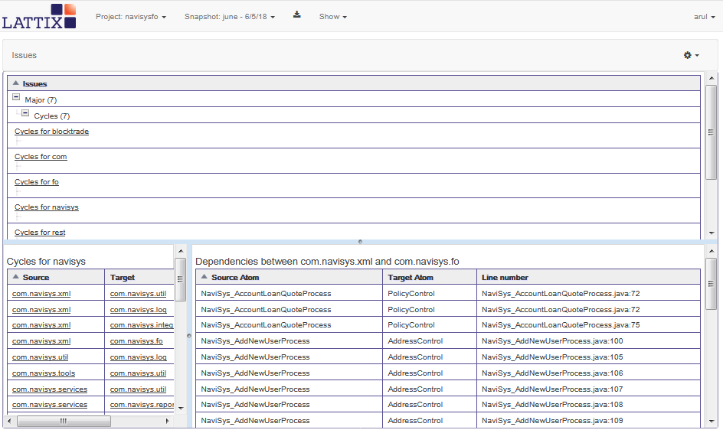
Lattix Web Issues

Slide 15
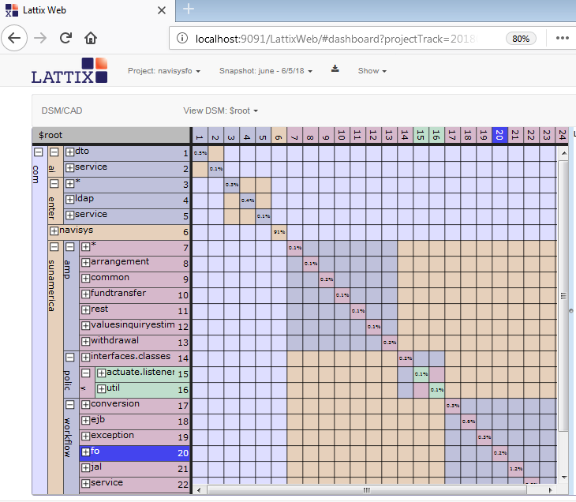
DSM in Lattix Web

Slide 16
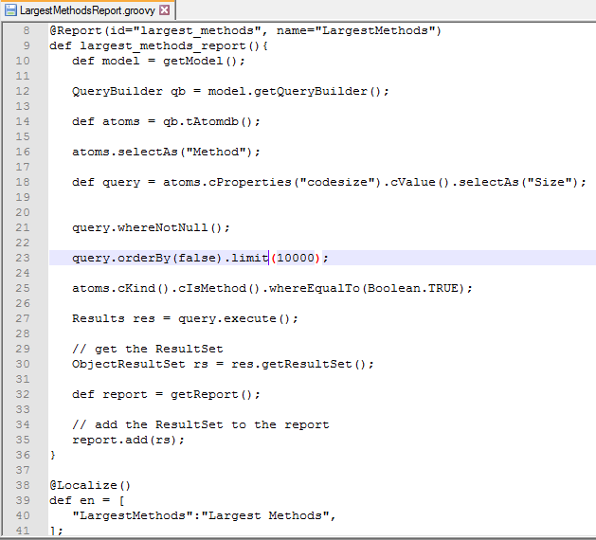
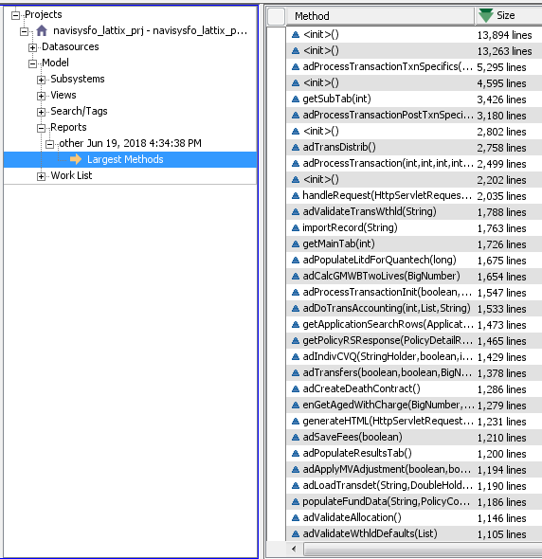
Lattix
Scripting
Custom Script to get Larger Methods
Lattix Custom Report by Custom Script

Slide 17
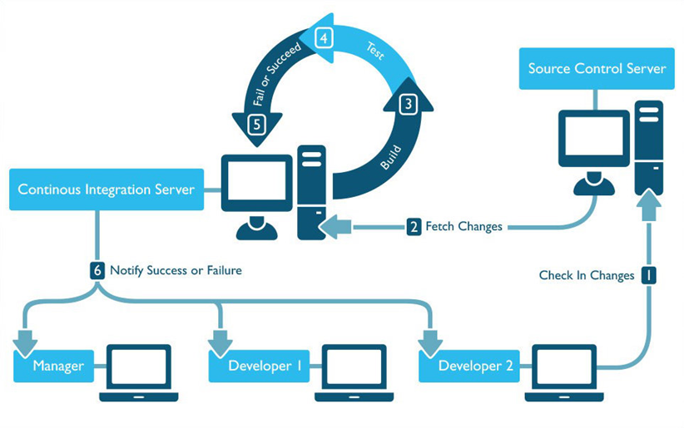
Lattix
Continuous Integration & Continuous Delivery Cycle

Slide 18
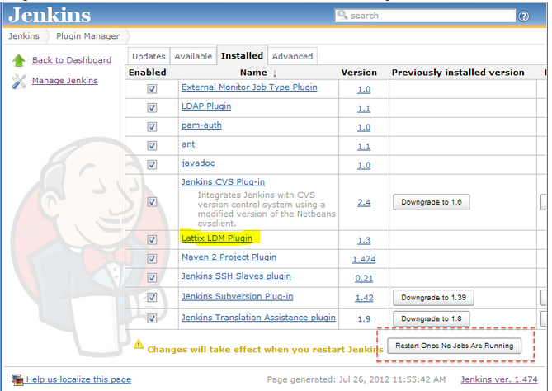
Lattix over Jenkins
C I / C D

Slide 19
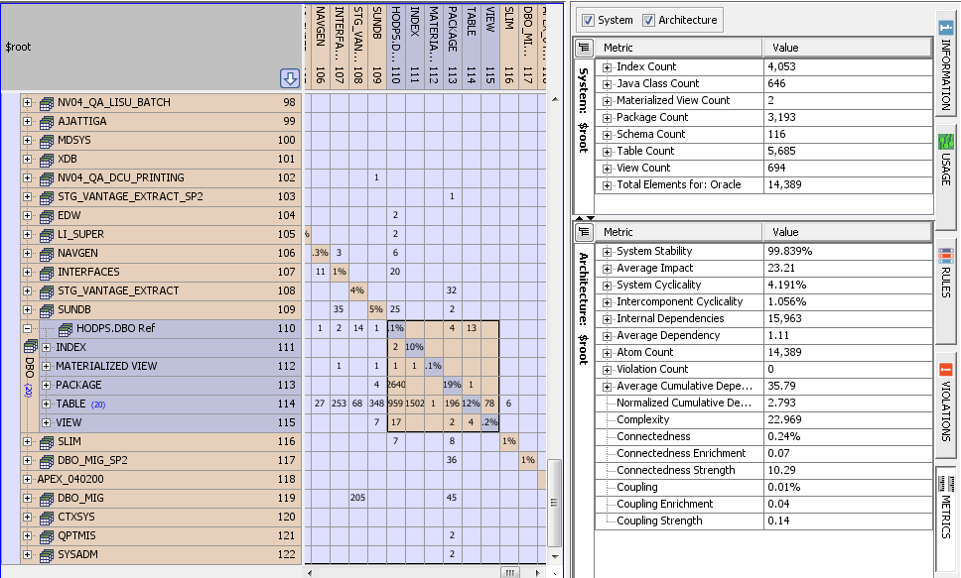
Lattix over Database
(HODPS Database is used for Lattix Analysis)

Slide 20
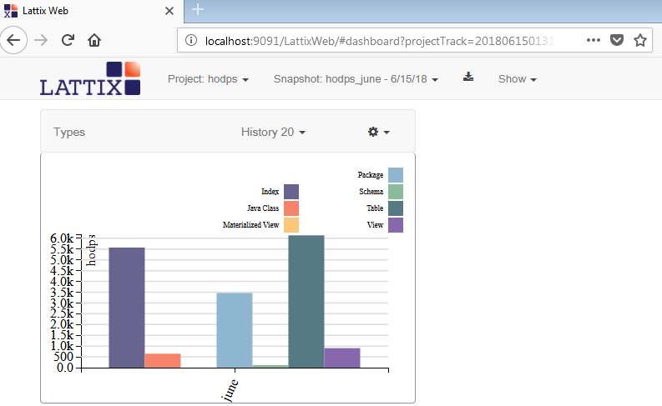
Lattix Web Report on Database
(HODPS Database is used for Lattix Analysis)

Slide 21
Few Additional Tools
For
Developers & Leaders
JSP Pre-compilation Tool
JSP Analyzer
JavaScript Analyzer
Java Constant Analyzer
Oracle Audit Script
Python Analyzer
Oracle Pro*C Analyzer
iBatis Analyzer
Note: Slides not included for Python Analyzer, Oracle Pro*C & iBatis in this presentation

Slide 22
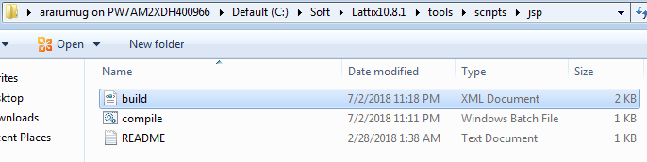
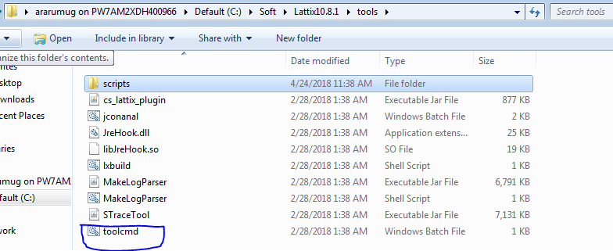
Lattix JSP Pre-compilation Tool
Lattix JSP Pre-Compilation Script
Direct JSP file Analyzing tool
(below snap has syntax to execute this command)

Slide 23
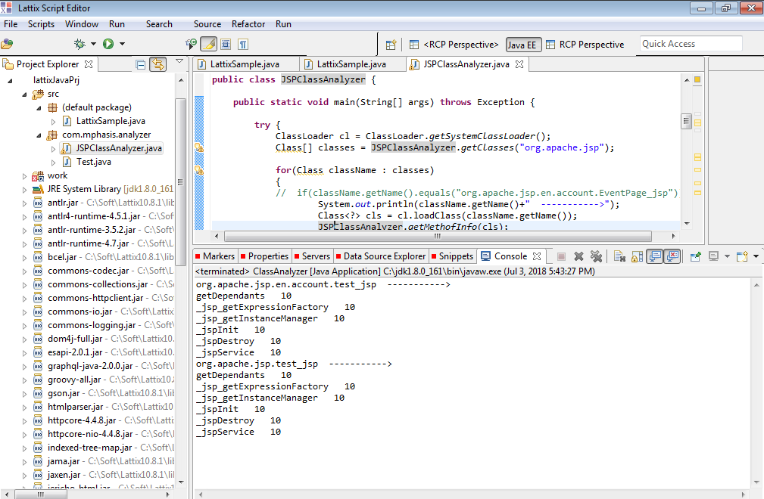
JSP Class file Analyzer
_jsp.class file Analyzer Script

Slide 24
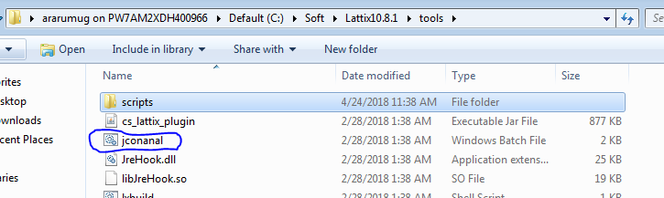
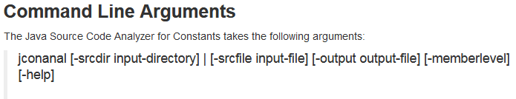
Lattix - Java Constants Analyzer
Note:The Java compiler inlines the constants. As a result, the relationship between the definition of constants and their references cannot be seen in Java byte code
This Lattix tool helps us to find dependencies between Java classes that are based on constants

Slide 25
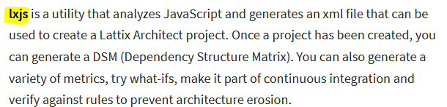
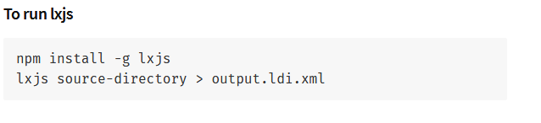
Lattix - JavaScript Analyzer

Slide 26
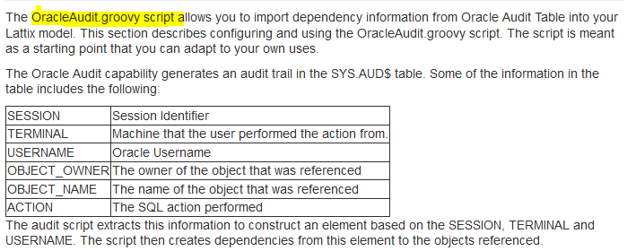
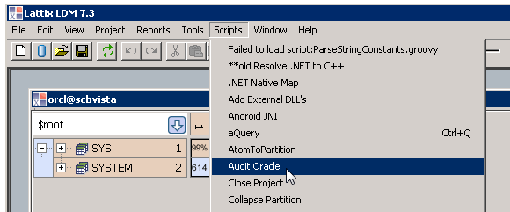
Lattix – Oracle Audit

Slide 27


